Slide 1
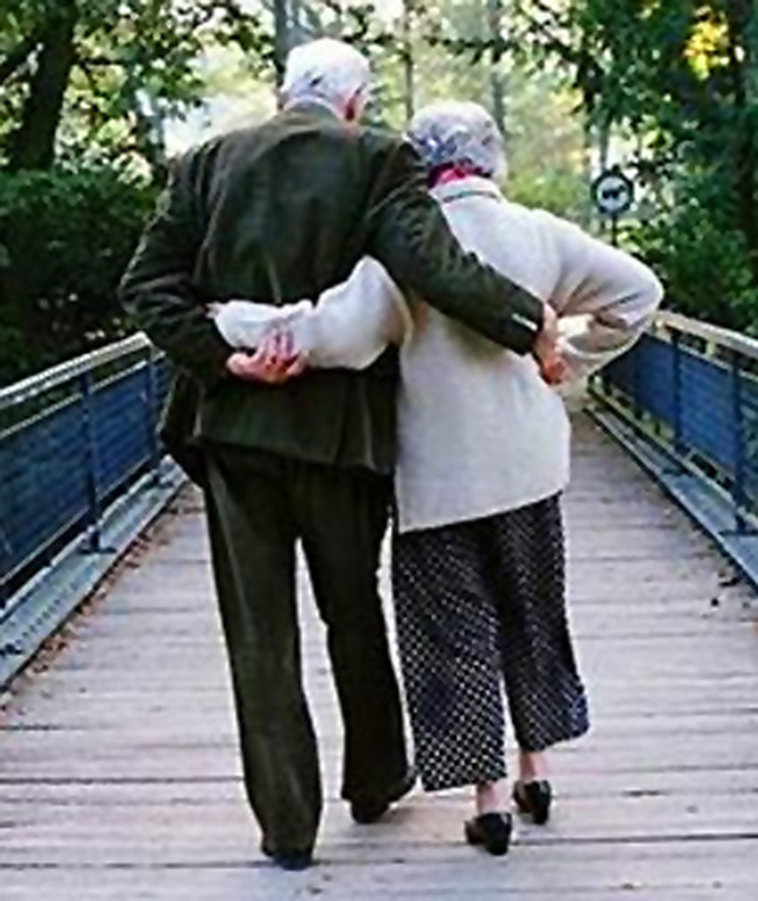
Married: Growing & Serving Together
A Study of Marriage, Spring 2023

Slide 2
Living Together With “Understanding”
“Likewise, husbands, live with your wives in an understanding way, showing honor to the woman as the weaker vessel, since they are heirs with you of the grace of life, so that your prayers may not be hindered.” 1 Peter 3:7

Slide 4
The Love Languages
“If I speak in the tongues of men and of angels, but have not love, I am a noisy gong or a clanging cymbal. And if I have prophetic powers, and understand all mysteries and all knowledge, and if I have all faith, so as to remove mountains, but have not love, I am nothing.” I Corinthians 13:1-2

Slide 5
Love Language # 1 Words of Affirmation
Using our words to affirm and encourage our spouse
Focused on areas they are good at or where they need support

Slide 6
Love Language # 1 Words of Affirmation
“Death and life are in the power of the tongue, and those who love it will eat its fruits.” Proverbs 18:21

Slide 7
Love Language #1 Words of Affirmation
“Anxiety in a man’s heart weighs him down, but a good word makes him glad.” Proverbs 12:25

Slide 8
Love Language #1 Words of Affirmation
“Let your speech always be gracious, seasoned with salt, so that you may know how you ought to answer each person.” Colossians 4:6

Slide 9
Love Language #1 Words of Affirmation
Using words of kindness (Love is kind)
Using words of encouragement
Using words with humility

Slide 10
Love Language #1 Words of Affirmation
Your spouse is your partner, not a child
In marriage we are equal adult partners

Slide 11
Love Language # 2 Quality Time
Quality Time = Focused Attention
Giving each other time in our lives = giving our lives to each other
A powerful emotional communicator of love

Slide 12
Rank | Attribute | Notes
1 | Understanding towards me | Patient and loving
2 | Listens to my point of view | Hearing me and considering
3 | Spending time together | Ideas for the family
4 | Spiritual Leadership | Strength, leadership and growth
5 | Prioritites in order | Doing what's most needful
6 | Supportive of me | Not having to ask because he's aware
7 | Guidance | In all areas
8 | Capable with money | Having a plan/acting wisely
9 | Integrity | Building trust and confidence
10 | Attractive | Well groomed
11 | Romantic | Time together and intimacy
12 | Selfless | Putting family first

Slide 13
Love Language # 3 Receiving Gifts
Gifts can be visual symbols of love
Something you can hold in your hand that says I was thinking about you
You must be thinking of someone to give a gift

Slide 14
Love Language # 4 Acts of Service
Acts of service require thought, planning, time effort and energy
Defined as “A demonstration of our love by accomplishing tasks that we know will assist our partner and make their life easier or more enjoyable.”

Slide 15
Love Language # 4 Acts of Service
“But a Samaritan, as he journeyed, came to where he was, and when he saw him, he had compassion. He went to him and bound up his wounds, pouring on oil and wine. Then he set him on his own animal and brought him to an inn and took care of him. And the next day he took out two denarii and gave them to the innkeeper, saying, ‘Take care of him, and whatever more you spend, I will repay you when I come back.’ Luke 10:33-35

Slide 16
Love Language # 4 Acts of Service
“For I have given you an example, that you also should do just as I have done to you.” John 13:15–16

Slide 17
Love Language # 5 Physical Touch
No mystery that physical touch is a way to communicate love
Babies that are held, hugged and kissed develop into young people that have much healthier emotional lives

Slide 18
Love Language # 5 Physical Touch
In our culture, shaking hands communicates openness and social closeness
If someone refuses to shake your hand it sends the message that things are not right in the relationship

Slide 19
Love Language # 5 Physical Touch
Physical touch is a powerful way to communicate marital love
Not always fulfilled in the sexual relationship
Holding hands, or putting your arm around each other
Hugging or kissing

Slide 20
Love Language # 5 Concluding Thoughts…
These ideas build on the scriptural principle of “living together with understanding”
Identifying the “love language” of our spouse opens the possibility to a much deeper and satisfying relationship
Which more fully reflects the design for marriage that God intended from the beginning

Slide 21
Living Together With “Understanding”
“Likewise, husbands, live with your wives in an understanding way, showing honor to the woman as the weaker vessel, since they are heirs with you of the grace of life, so that your prayers may not be hindered.” 1 Peter 3:7

